Slide 1
Population, Migration and Human Resources
Sunil Dagar

Slide 2
Table of Contents
Population and its Distribution; Density of Population
Basic Concepts of Population Geography
Components of Population Change
Migration : Types & Causes
Population Composition
Population Pyramid (Age-Sex Pyramid)
Religious Communities of India
Human Resources
Human Development
Four Pillars of Human Development
Approaches to Human Development
Human Development Index
Gross National Happiness (GNH)
Miscellaneous Topics
India- Cultural regions; World Heritage Sites
Sunil Dagar

Slide 3
Population
Population is an Asset or a Liability?
Sunil Dagar

Slide 4
Factors influencing Population Distribution
Sunil Dagar

Slide 5
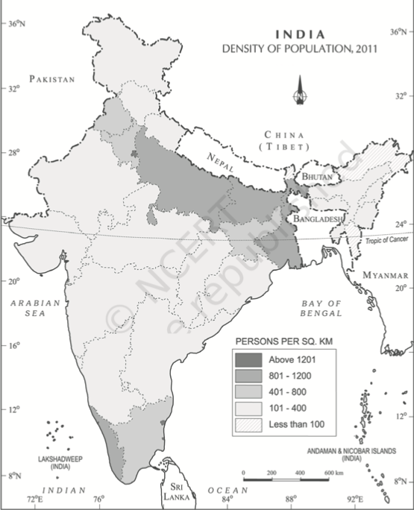
Spatial variation of population densities in India
Sunil Dagar

Slide 6
Basic Concepts of Population Geography
Sunil Dagar

Slide 7
Components of Population Change
Sunil Dagar

Slide 8
Migration
Types of Migration
Causes of Migration
Sunil Dagar

Slide 9
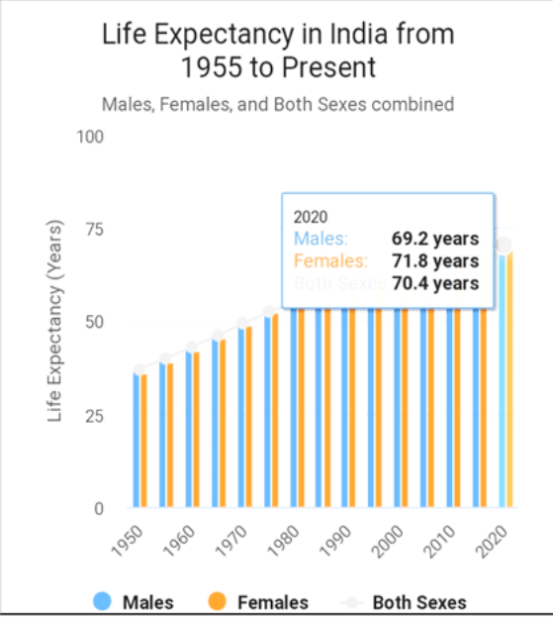
Population Composition
Sunil Dagar

Slide 10
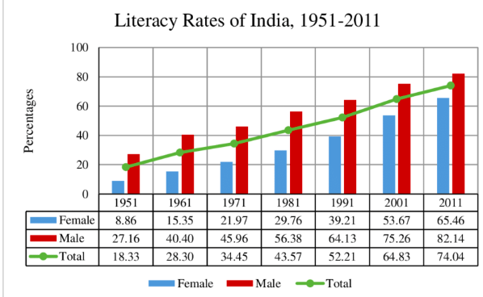
Sunil Dagar

Slide 11
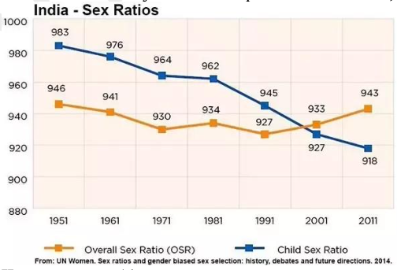
Sunil Dagar

Slide 12
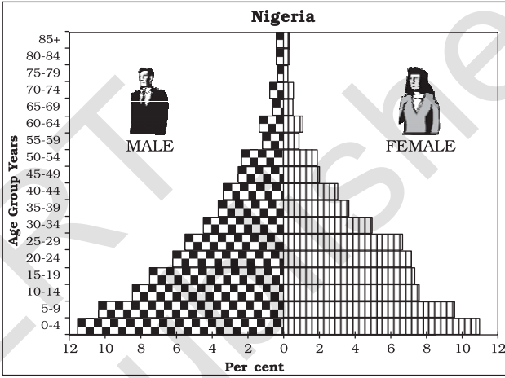
Population Pyramid (Age-Sex Pyramid)
It tells us about the age, sex ratio, dependent population, etc.
Expanding Populations
The age-sex pyramid of Nigeria is a triangular shaped pyramid with a wide base and is typical of less developed countries.
These have larger populations in lower age groups due to high birth rates. (Bangladesh and Mexico )
Sunil Dagar

Slide 13
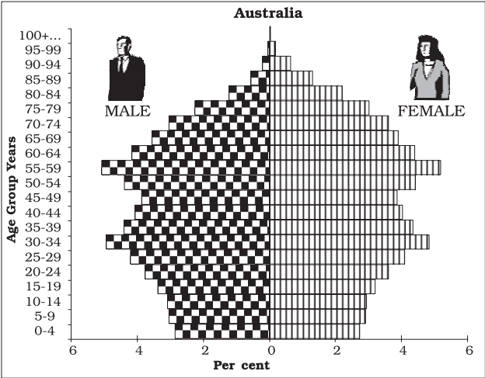
Constant Population
Australia’s age-sex pyramid is bell shaped and tapered towards the top.
This shows birth and death rates are almost equal leading to a near constant population
Sunil Dagar

Slide 14
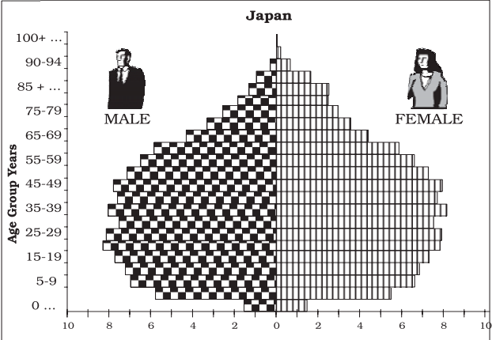
Declining Population
The Japan pyramid has a narrow base and a tapered top showing low birth and death rates.
The population growth in developed countries is usually zero or negative.
Sunil Dagar

Slide 15
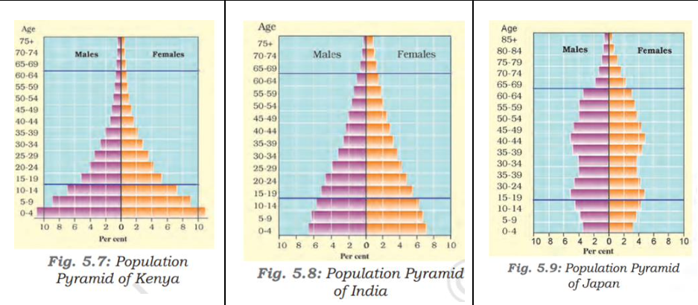
Sunil Dagar

Slide 16
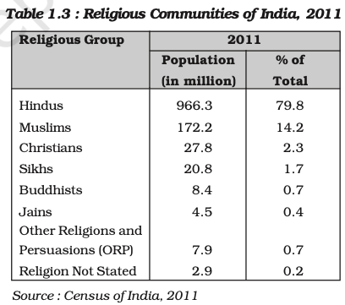
Religious Communities of India
Sunil Dagar

Slide 17
Human Resources
Sunil Dagar

Slide 18
Human Development
Growth vs Development
Sunil Dagar

Slide 19
Four Pillars of Human Development
Equity: It refers to making equal access to opportunities available to everybody irrespective of their gender, race, income and in the Indian case, caste.
Sustainability: It means continuity in the availability of opportunities.
To have sustainable human development, each generation must have the same opportunities.
All environmental, financial and human resources must be used keeping in mind the future.
Productivity: It here means human labour productivity or productivity in terms of human work.
Such productivity must be constantly enriched by building capabilities in people, who are the real wealth of nations.
Therefore, efforts to increase their knowledge, or provide better health facilities ultimately leads to better work efficiency.
Empowerment: It means to have the power to make choices.
Such power comes from increasing freedom and capability.
Good governance and people-oriented policies are required to empower people.
The empowerment of socially and economically disadvantaged groups is of special importance.
Sunil Dagar

Slide 20
Approaches to Human Development
(a) Income Approach : This is one of the oldest approaches to human development.
The idea is that the level of income reflects the level of freedom an individual enjoys.
Higher the level of income, the higher is the level of human development.
(b) Welfare Approach
This approach looks at human beings as beneficiaries or targets of all development activities.
The approach argues for higher government expenditure on education, health, social secondary and amenities.
People are not participants in development but only passive recipients.
(c) Basic Needs Approach
This approach was initially proposed by the International Labour Organisation (ILO).
Six basic needs i.e.: health, education, food, water supply, sanitation, and housing were identified.
The question of human choices is ignored and the emphasis is on the provision of basic needs of defined sections
(d) Capability Approach: This approach is associated with Prof. Amartya Sen.
Building human capabilities in the areas of health, education and access to resources is the key to increasing human development.
Sunil Dagar

Slide 21
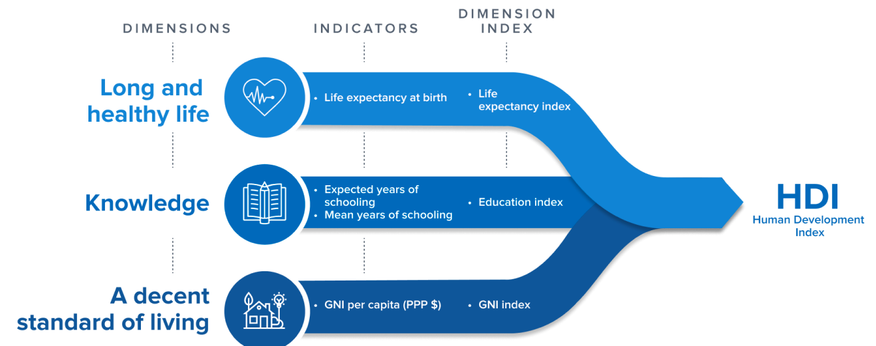
Human Development Index (191 nations by UNDP since 1990)
Sunil Dagar

Slide 22
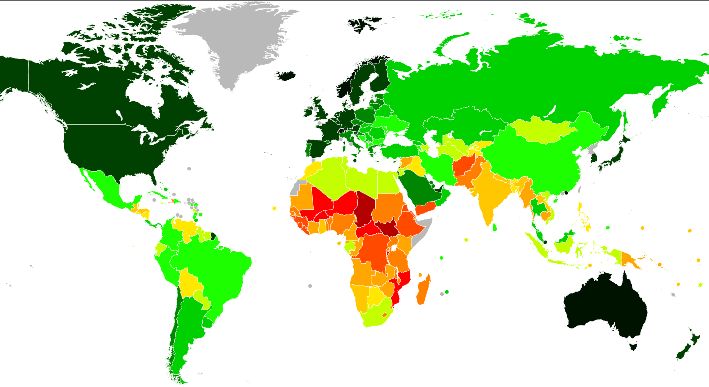
Sunil Dagar

Slide 23
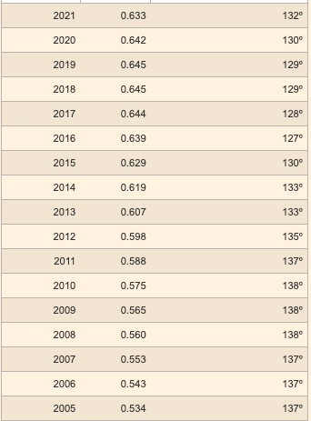
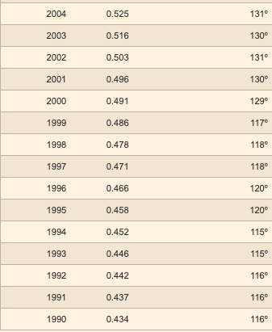
India- HDI
Sunil Dagar

Slide 24
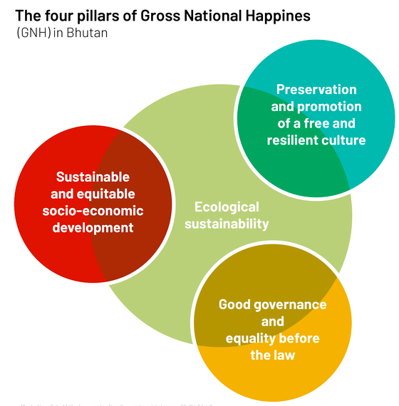
Gross National Happiness (GNH)
Bhutan is the only country in the world to officially proclaim the Gross National Happiness (GNH) as the measure of the country’s progress.
Sunil Dagar

Slide 25
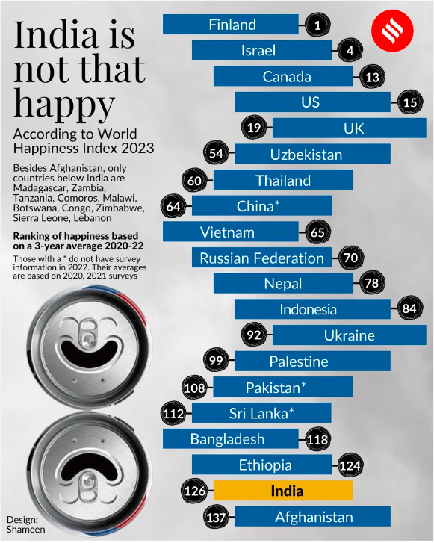
World Happiness Report (UN- Sustainable Development Solutions Network)
The ranking uses six key factors to measure happiness — social support, income, health, freedom, generosity, and absence of corruption.
India ranks at 126th position (out of 146 countries)
Sunil Dagar

Slide 26
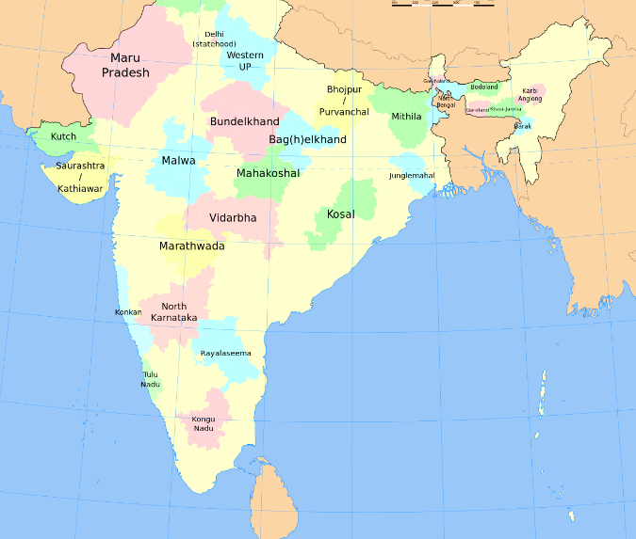
Miscellaneous Topics
India- Cultural regions
Sunil Dagar

Slide 27
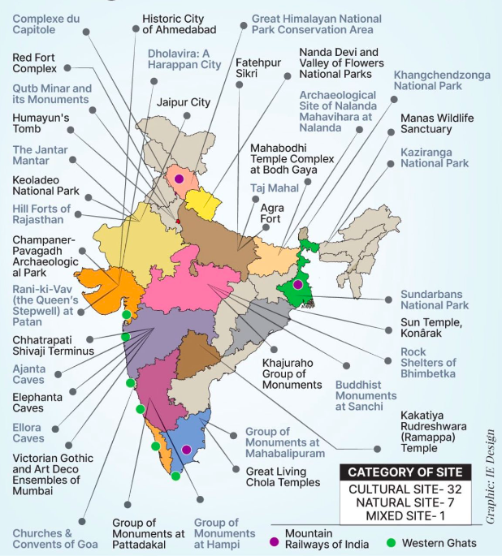
World Heritage Sites in India (UNESCO)
Total 42 (34 Cultural + 7 Natural + 1 mixed)
Recent additions
Santiniketan - West Bengal
Hoysala temples of Belur, Halebid and Somananthpura- Karnataka
Natural Sites in India (7)
Great Himalayan National Park Conservation Area (HP)
Nanda Devi and Valley of Flowers National Parks (Uttarakhand)
Keoladeo National Park (Rajasthan)
Sundarban National Park (WB)
Western Ghats
Kaziranga National Park (Assam)
Manas Wildlife Sanctuary (Assam)
Mixed Site-(Khangchendzonga/Kanchenjunga National Park, Sikkim)
Sunil Dagar
Sunil Dagar

Slide 28
H.P (Mountain Railways of India) + W.B + T.N -1
Delhi ( Humayun’s Tomb, Qutub Minar, Red Fort Complex) - 3
Chandigarh (Architectural Work of Le Corbusier (Capitol Complex) - 1
Rajasthan (Jantar Mantar, Hill Forts of Rajasthan, Jaipur City) - 3
Gujarat (Champaner-Pavagadh Archaeological Park, Rani Ki Vav (The Queen’s Stepwell), Historic City of Ahmedabad, Dholavira, a Harappan City)- 4
Uttar Pradesh (Agra Fort, Taj Mahal, Fatehpur Sikri) - 3
Bihar (Mahabodhi Temple Complex at Bodh Gaya, Archaeological Site of Nalanda Mahavira at Nalanda) - 2
West Bengal (Shantiniketan) - 1
Odisha (Sun Temple, Konark) - 1
Madhya Pradesh (Khajuraho Group of Monuments, Buddhist Monuments at Sanchi, Rock Shelters of Bhimbetka) - 3
Maharashtra (Ajanta Caves, Ellora Caves, Elephanta Caves, Chhatrapati Shivaji Terminus (formerly Victoria Terminus, Victorian Gothic and Art Deco Ensembles of Mumbai) - 5
Goa (Churches and Convents of Goa) - 1
Telangana (Kakatiya Rudreshwara (Ramappa) Temple) - 1
Karnataka (Group of Monuments at Hampi, Group of Monuments at Pattadakal, Sacred Ensembles of the Hoysala) - 3
Tamil Nadu (Group of Monuments at Mahabalipuram, Great Living Chola Temples) - 2
Sunil Dagar
Sunil Dagar

Slide 29
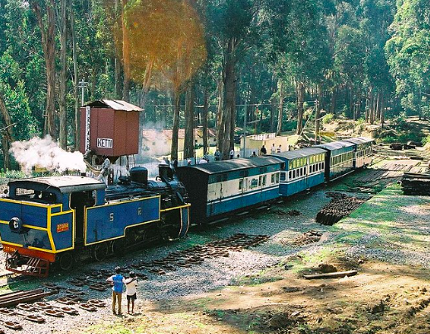
Sunil Dagar

Slide 30


Sunil Dagar

